Slide 1
Effective Kubernetes
Aka People says K8S runs on your fridge till 2020

Slide 2





2016

Slide 3
Success
Slow rollouts
XX% Idle Machine
Continuous Deployment?
Technical Debt
Fear
Frustration

Slide 4
Black (Blue) Box
Infrastructure (almost) invisible
Easy* Continuous Deployment
https://en.wikipedia.org/wiki/File:Dr_Who_(316350537).jpg

Slide 5
Common Language Artifacts Platform

Slide 6

Learn-as-you-go
https://www.flickr.com/photos/bruno_brujah/

Slide 7

Learn-as-you-go
1. Deploy Cloud-Native app
2. Make a Hell of Mistakes
3. Get it right or Postpone

Slide 8

Three ways:
Flow
Feedback
Continuous Experimentation and Learning

Slide 9
Keep it simple

Slide 10


Continuous Deployment
Dev
Staging
Prod
Azure Kubernetes Service

Slide 11
Continuous Deployment
make run_locally
Code on (signal) dev → dev cluster
Code on master → dev cluster

Slide 12
Continuous Deployment
3. Git tag → dev staging
4. PR accepted → production

Slide 13
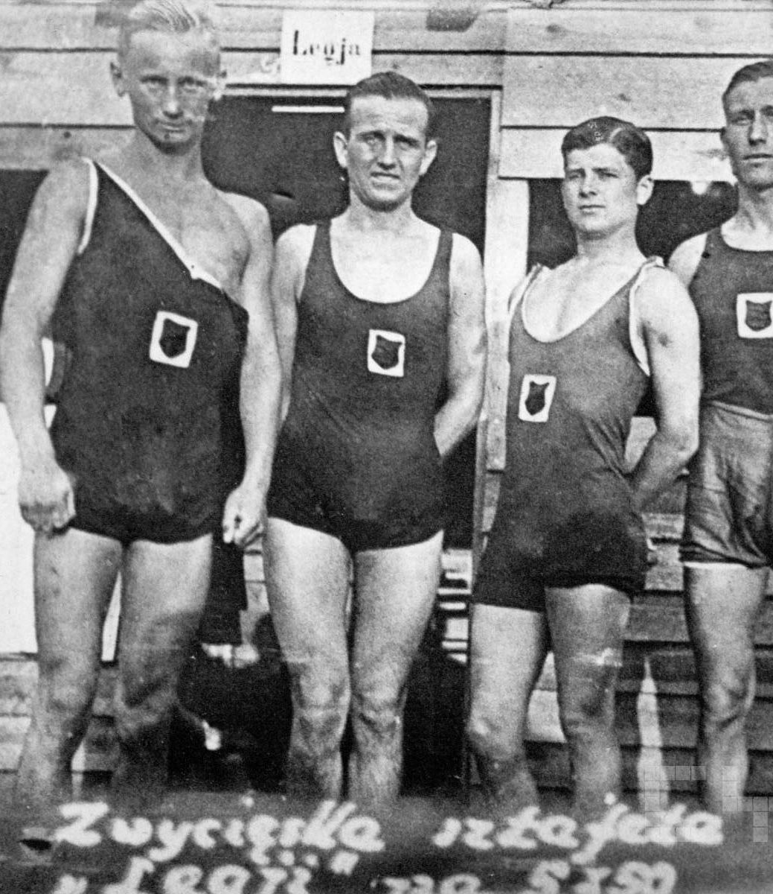
Keep everybody in the process
Teach the team Kubernetes definitions.
Keep the CD understandable
Keep K8S files easy to read
Do not terrorize with amazingly-easy-CD-with-Kubernetes :D

Slide 14
Keep everybody in the process
Copy&paste:
Makefile
TravisCI
Kubernetes files
No encrypted secrets in repo
curl https://github.com/smacc-ci/deploy.sh | bash

Slide 15
Application must be smarter (12factorapps, migrations, …)
https://www.flickr.com/photos/160866001@N07/

Slide 16
Long story…
Endpoints:
health/
info/
metrics/
Fast restart

Slide 17
Conventions over tools
Common conventions for repos
Not a single deploying tool
Only when you are really really ready

Slide 18
??
Resource limits still hard
Prometheus alert rules still hard
How to get the Grafana dashboard definitions from application
Consider CRT

Slide 19
Effective Kubernetes
Start with small iterations
Learn-as-you-go
Simplicity
Keep your K8S understandable

